Slide 1
The Physical Layer

Slide 2
Agenda
Physical layer
Modulation
Multiplexing
Error Correction
Encoding
Crimping
Wireless
Tasks for today
References

Slide 3
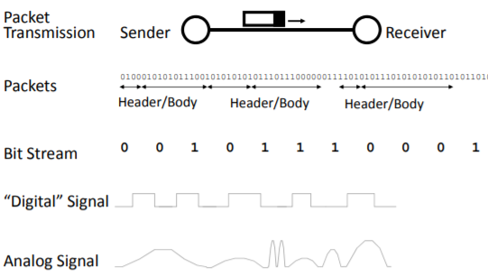
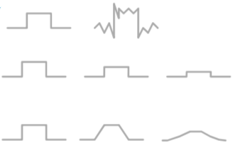
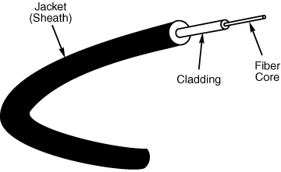
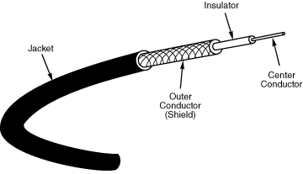
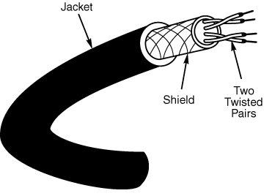
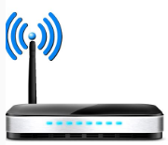
Physical layer
Information transfer is a physical process.
Sender, Receiver and Medium.
Goal: Information sender transmits receiver has to understand.
Think about terminology:
Signal
Modulation
Information
What we don’t want:
Noise
Attenuation
Dispersion

Slide 4
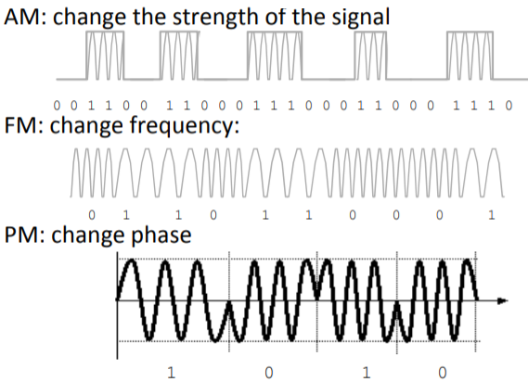
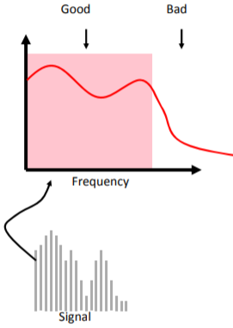
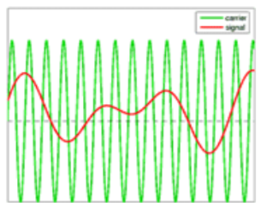
Modulation
Sender changes the signal in a way that receiver can recognize information.
Ways to modulate signal - change frequency, phase or amplitude
Choice of transmitter & receiver complexity, power requirements, bandwidth, medium, noise immunity, range, multiplexing options.
Bandwidth: width of frequency range in which fourier transform of signal is non zero. The channel width.
Goal for sender and receiver: Maximize useful bandwidth given channel properties.

Slide 5
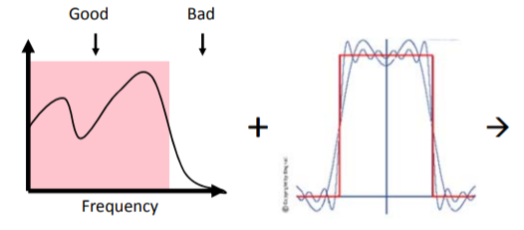
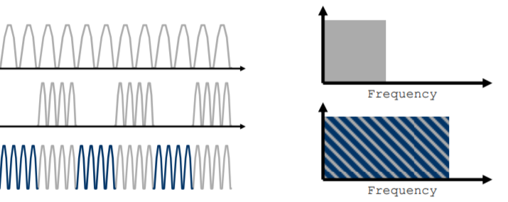
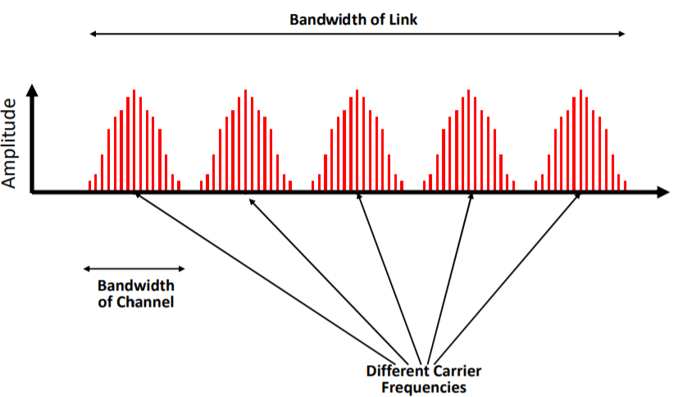
Multiplexing
Nyquist Limit - A noiseless channel of width H can at most transmit a binary signal at a rate of 2 x H.
A 3000 Hz channel can transmit data at a rate of at most 6000 bits/second.
How can multiple people communicate at same time?
Transmit a different frequencies, different time or at different space.
Frequency - Different users use different part of spectrum.
Time - Who gets to spend when.
Space - Limit power.

Slide 6
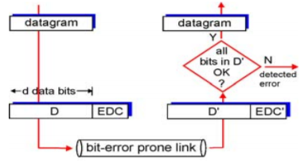

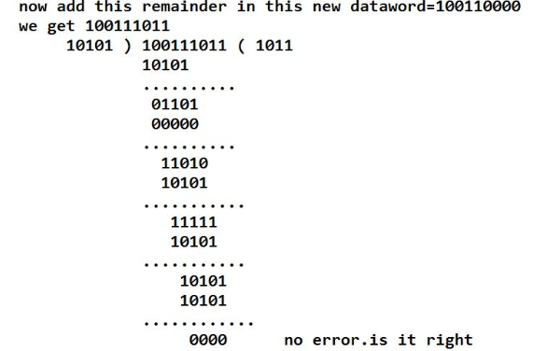
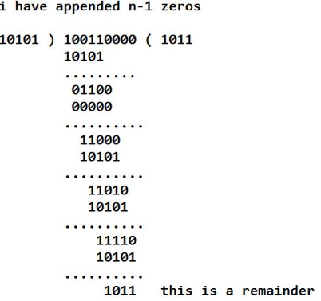
Error Correction
Transmission may introduce errors into the communication, i.e receive digital signal is different from the sent.
Detection - Require extra bits
Correction - forward error correction
Common Techniques
Parity bits
Cyclic redundancy checks

Slide 7
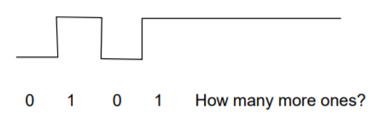
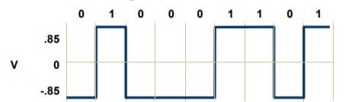
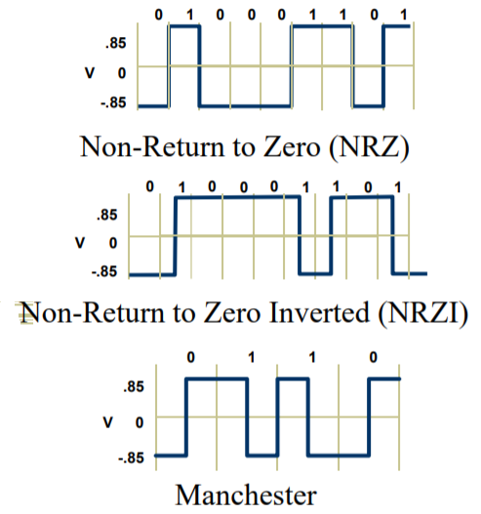
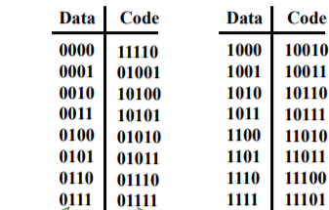
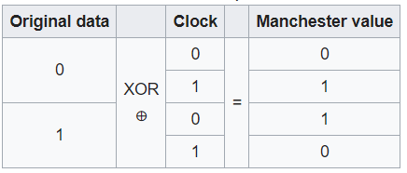
Encoding
Keep receiver synchronized with the sender.
Create control signals in addition to data signals.
Change bit stream so that there are enough transitions in signal.
Encoding and modulation work together
Little bandwidth - complex encoding.
Lot of bandwidth - simple encoding.
Examples:
8B/10B encoding for fiber channel and gigabit ethernet
64B/66B encoding for 10 Gbit ethernet (40 and 100 gb/s)
4B/5B encoding in FDDI

Slide 8
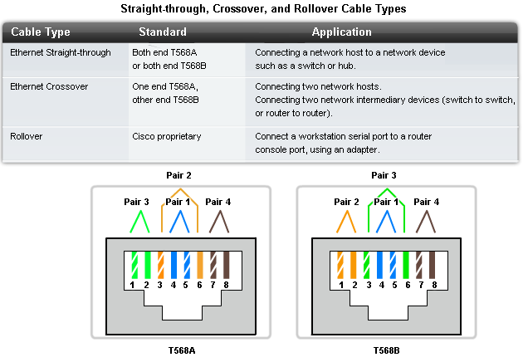
Crimping

Slide 9
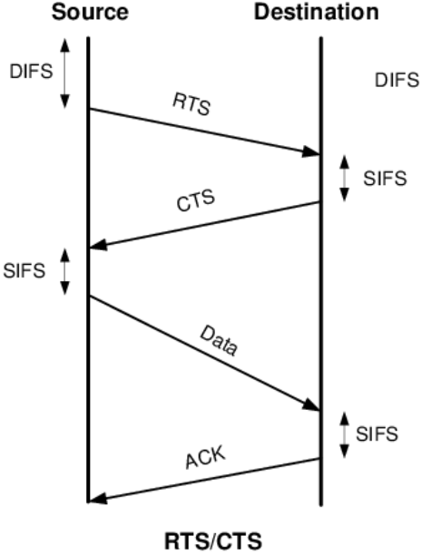
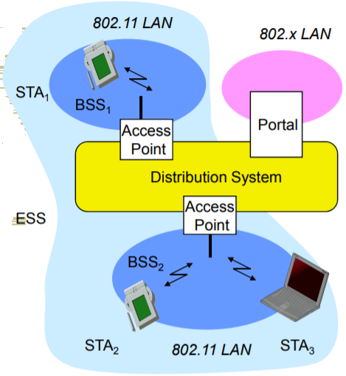
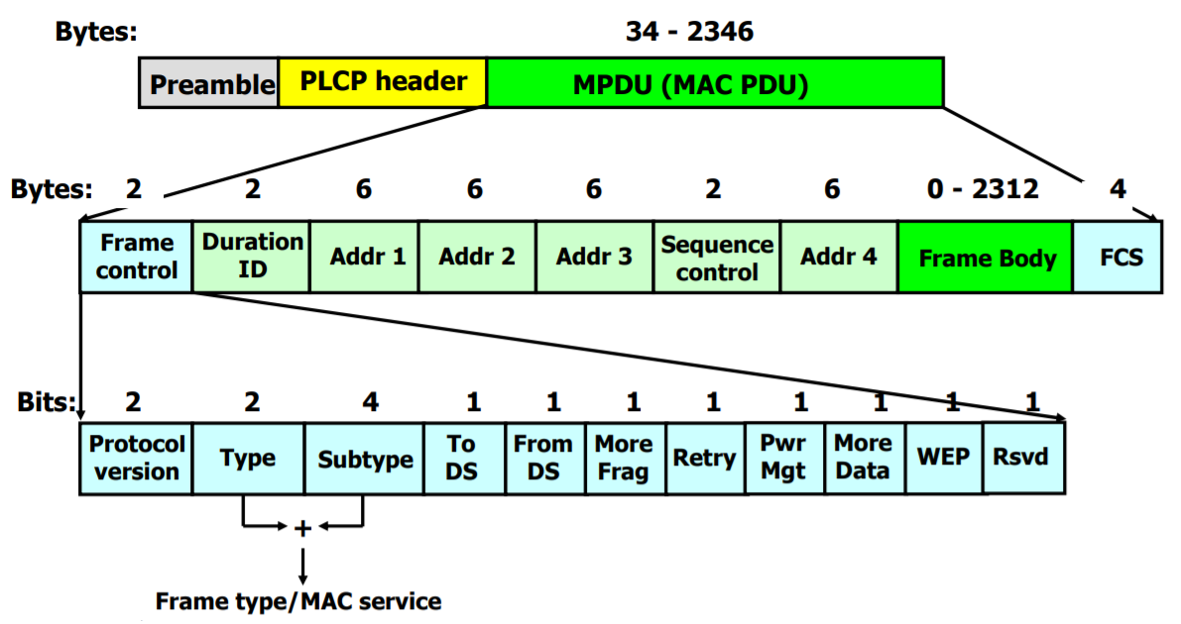
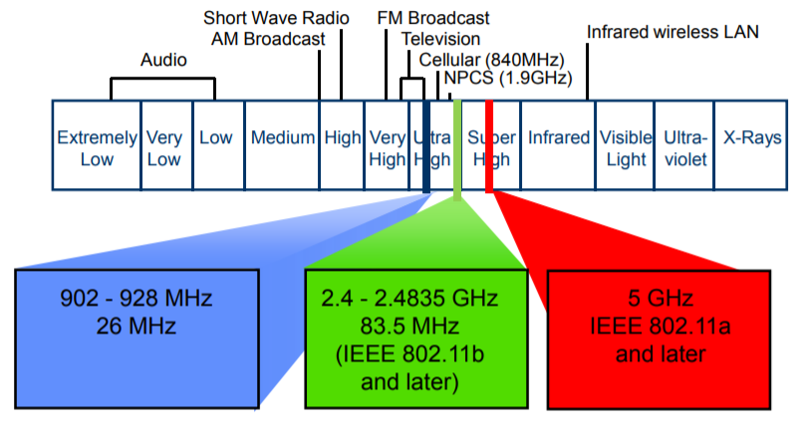
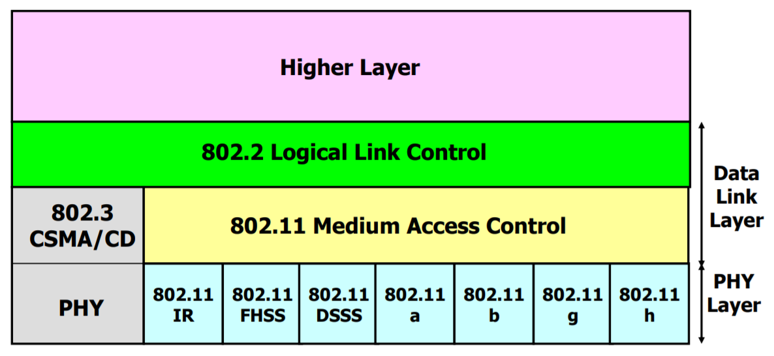
Wireless
Wireless networks are standardised into IEEE 802 LAN MAN
Uses radio frequency
Uses random access and reservation packets for collision avoidance.
RTS (Request to send) / CTS (Clear to send) with ack packets under network allocation vector.

Slide 10
Tasks for Today
LAN cable crimping - straight through and crossover.
Network tour - identification of devices , labeling devices, creating a network diagram of MSIT division.
Wireshark task for analyzing wired/wireless data.
Observing physical layer data in wired / wireless medium.

Slide 11
References
https://en.wikipedia.org/wiki/Physical_layer
https://en.wikipedia.org/wiki/Ethernet_physical_layer
https://en.wikipedia.org/wiki/Wi-Fi
https://upload.wikimedia.org/wikipedia/commons/thumb/d/df/United_States_Frequency_Allocations_Chart_2011_-_The_Radio_Spectrum.pdf/page1-6300px-United_States_Frequency_Allocations_Chart_2011_-_The_Radio_Spectrum.pdf.jpg
https://en.wikipedia.org/wiki/Cyclic_redundancy_check
https://en.wikipedia.org/wiki/Manchester_code

Slide 12
Question and Answers (Q&A)
Thank you.

